Slide 1
Teradata In-database Graph Functions
David Chan, Distinguished Data Scientist
Karthik Guruswamy, Financial Services AI Strategy Lead
Notes:
Hello and good morning/afternoon everyone, and welcome to today's session on…...
I’m ……
And with me is …..
We are excited to share how …….
Let’s take a quick look at what we have planned for today’s session.

Slide 2
Executive Summary
In-database Graph Functions
Overview
As organizations manage increasingly interconnected data, including customer relationships, supply chains, fraud networks, and knowledge graphs, the ability to analyze complex relationships at scale has become a strategic priority.
Traditional relational databases were not designed for this type of analysis.
In-database graph functionality addresses this gap by embedding native graph processing directly within the enterprise data platform and eliminating the need to extract, transform, and move data to a separate graph engine.
Problem
Relationship-intensive analytics often require organizations to run a separate graph database alongside their primary data platform.
This creates friction due to duplicated data, complex pipelines, fragmented governance, and limited ability to join graph results with existing analytical data.
The outcome is higher costs, increased latency, and added operational complexity.
Solution
In-database graph functions bring graph traversal, path analysis, and network analytics directly into the SQL execution environment.
Users can express graph queries such as shortest path, community detection, centrality scoring, and subgraph matching using familiar SQL syntax or purpose-built graph extensions, while operating directly on data where it already resides.
There is no data movement, no separate system to manage, and no additional cost.

Slide 3
Introduction
In-database Graph Functions
Teradata Stored Procedures
Each graph algorithm is delivered as a stored procedure that accepts input parameters such as the
source table, node and edge column names, a starting node, or a depth limit. The procedure
encapsulates all execution logic within Teradata. As a result, graph functions can be invoked like any
other database procedure, secured through standard Teradata role management, and versioned and
deployed as native database objects.
Python Wrapper
TeradataGE, or Teradata Graph Engine, is a Python package that wraps stored procedure calls and
exposes each graph algorithm as a native Python method. It is designed as a companion to the
teradataml package, which is the official Teradata Python library for in-database analytics, and it
follows the same connection model, DataFrame conventions, and API style familiar to teradataml
users.

Slide 4
Architecture
Interface Layer
SQL Interface: Cliv2, ODBC, JDBC, Restful API
Python Interface: TeradataML
Procedure Layer
I/O Parameters
Volatile tables and Output tables creation
Query Orchestration
Execution Layer
Volatile tables for temporary process
Dynamic queries to support flexible input structure
Recursive queries for graph traversal nature
Exception Control
MPP architecture
Workload Management via TASM
Storage Layer
Input: Teradata Perm Table, OTF, NOS
Staging: Volatile Tables
Output: Volatile or Perm Table
In-database Graph Functions

Slide 5
Graph Input
In-database Graph Functions
Direction
Directed: A→B
Undirected A←→ B
Cost/Distance
Weighted
Unweighted

Slide 6
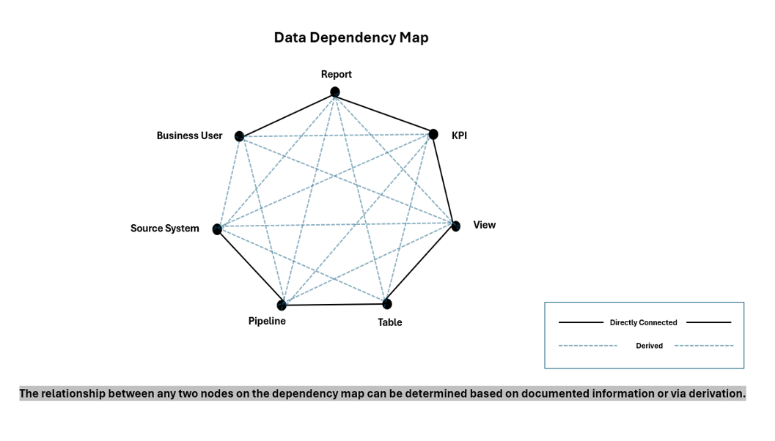
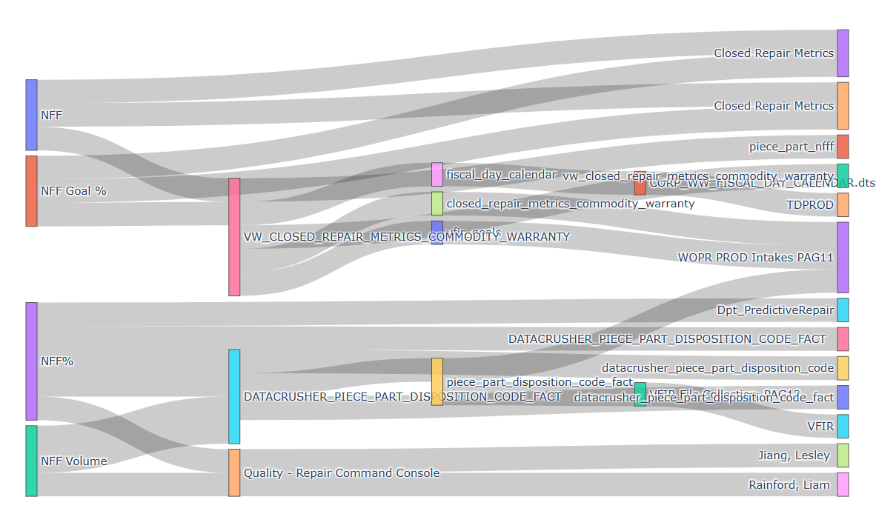
Use Case #1: Dependency Analysis for Data Lineage
In-database Graph Functions
What is it?
Dependency Analysis is the process of mapping how data flows from source to destination and tracking which tables, columns, and transformations depend on each other. It answers two critical questions:
Upstream: Where did this data come from: tracing back to the source.
Downstream: What breaks if I change this: tracing forward to all consumers.
Example:
This example builds a KPI lineage/details graph starting from Reports that have KPIs whose name starts with NFF, then walks downstream through:
Report → BusinessUser → KPI → View → Table → Pipeline → SourceSystem
returns the distinct set of those paths and nodes.

Slide 7
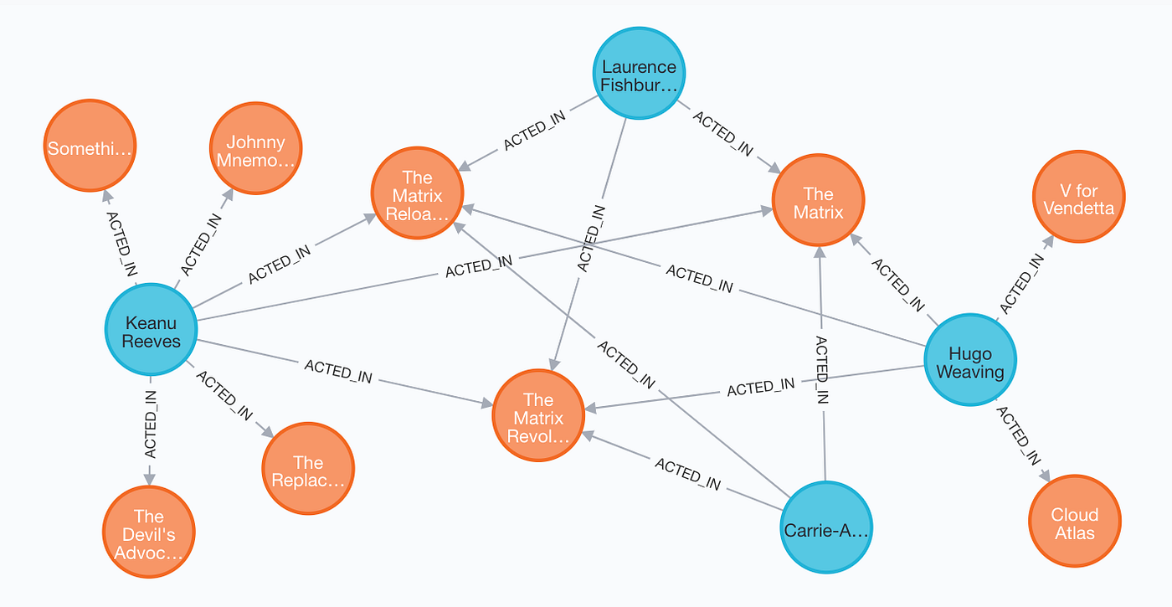
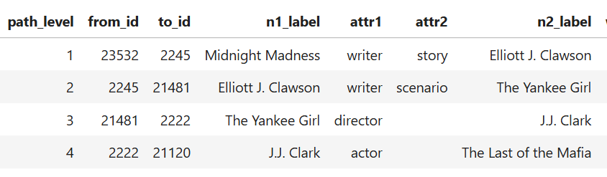
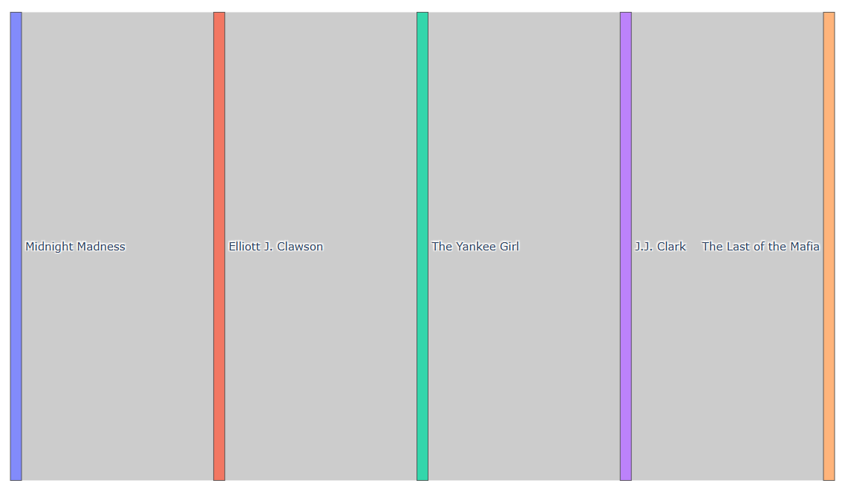
Use Case #2: Shortest path between 2 movies
In-database Graph Functions
What is it?
Identify the relationship between 2 movies
Example:
There is directed relationship between “Midnight Medness” and “Last of the Mafia”
But that have a relationship form between the actors and the movies

Slide 8
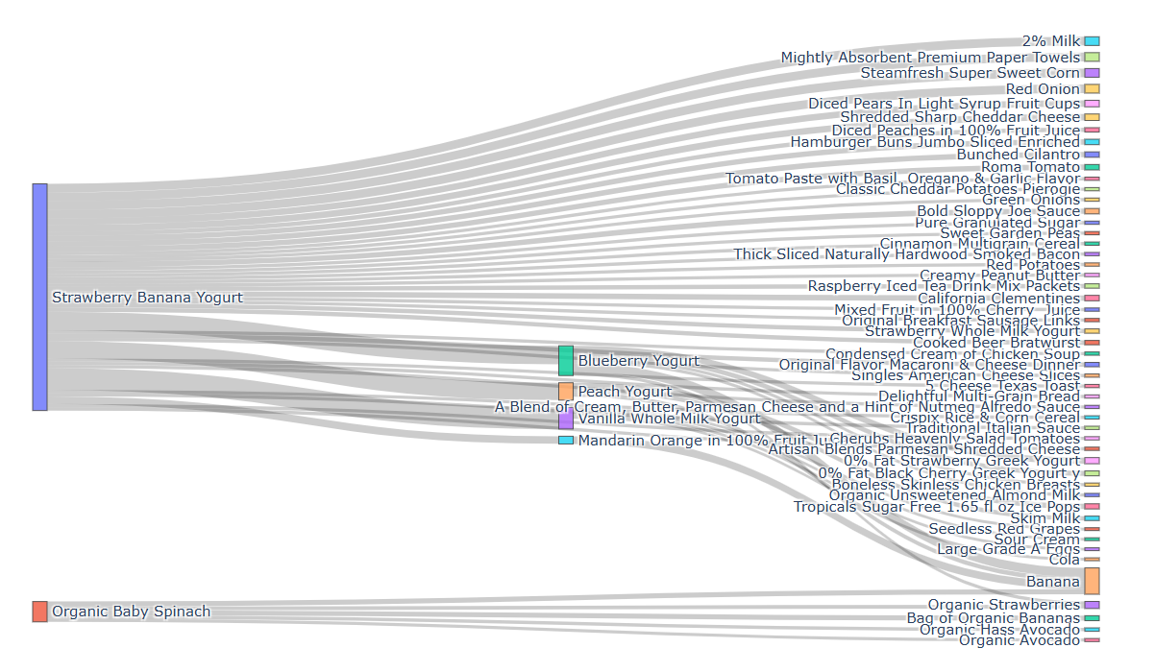
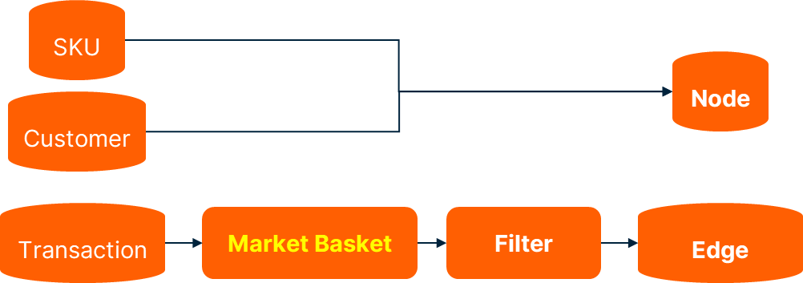
Use Case #3: Retail Product Recommendation
In-database Graph Functions
What is it?
Recommend the best products to the customer based on the item(s) added into the shopping basket
Example:
2 products have no direct relationship are added into baskets
Organ Baby Spinach
Strawberry Banana Yogurt
There are no direct connection between 2 products in the historical transactions
Both products have strong connection to Banana

Slide 9
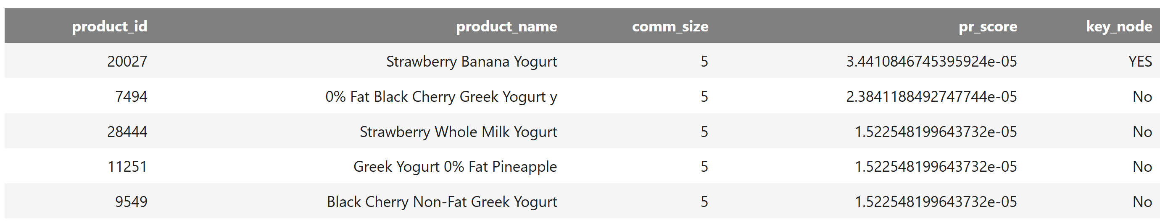
Community Recommendations
In-database Graph Functions
SKUs Community
Strawberry Whole Milk Yogurt
0% Fat Black Cherry Greek Yogurt
How it work?
Determines which set of products is relevant
Determines which products matter most within that set
Technique:
Community detection
PageRank
Why it is better than MBA?
Measures structural importance, not just frequency
Strawberry Banana Yogurt
Greek Yogurt 0% Fat Pineapple
Black Cherry Non-Fat Greek Yogurt

Slide 10
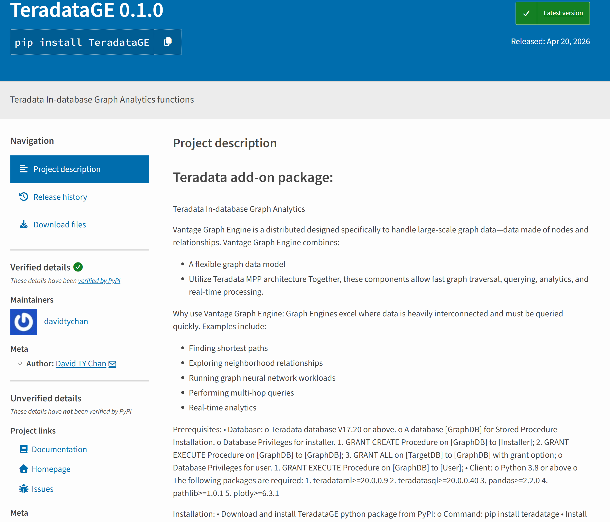
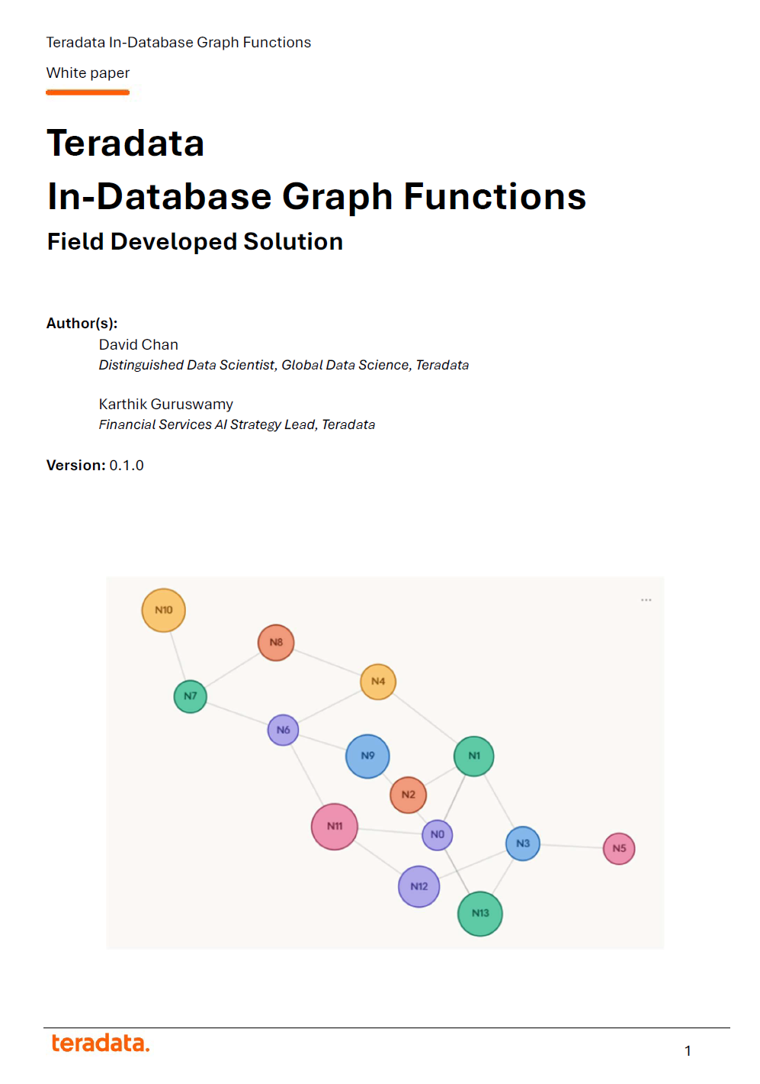
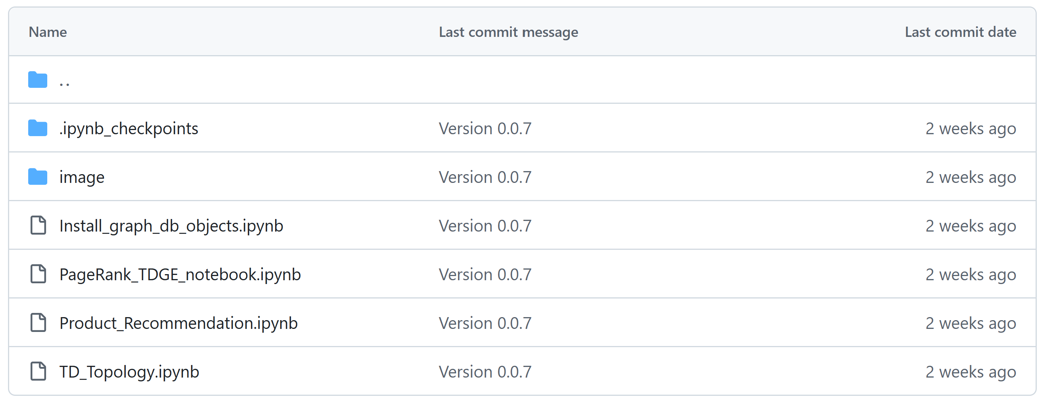
Graph Package
Graph Engines for Personalization
Python Package
Document
Demo Notebooks

